Slide 1
Introduction to Wireless Communication
Radio Communication

Slide 2
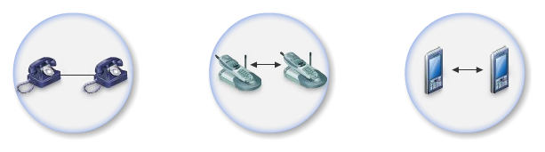
History of wireless communication (I)
pre-industrial age: line-of-sight communication using smoke/torch signaling
electrical telegraph invented in 1838 by Samuel Morse: wired communication using Morse codes
telegraph replaced by telephone network between 1870-1900
Guglielmo Marconi invented the wireless telegraph in 1896
  Communication by encoding alphanumeric characters in analog signal
  Sent telegraphic signals across the Atlantic Ocean
1914 – first voice communication over radio waves
Communications satellites launched in 1960s

Slide 3
History of wireless communication (II)
Advances in wireless technology
  Radio, television, mobile telephone, communication satellites
First computer network based on packet radio - ALOHANET at Univ. of Hawaii, 1971
1970-1990 - ad hoc wireless networks developed by the US military (DARPA)
1985 - first commercial wireless LAN appeared, but were a poor competitor for wired Ethernet
1960 - AT&T Bell Labs developed the cellular concept
1983 - first commercial cellular networks appeared in the USA; analog
1997 - first standard from the IEEE 802.11 family (Wi-Fi)

Slide 4
Basics of Wireless Communication

Slide 5
What is Wireless Communication ?
Transmitting voice and data using electromagnetic waves in open space (atmosphere)
Electromagnetic waves
    Travel at speed of light (c = 3x10⁸ m/s)
    Has a frequency (f) and wavelength (λ)
        c = f x λ
    Higher frequency means higher energy photons
    The higher the energy photon the more penetrating is the radiation

Slide 6
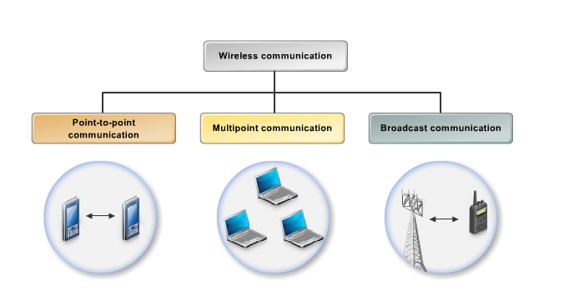
Types of wireless communication
celullar
wireless computer network
radio service

Slide 7
Types of wireless communication
Applications: voice, short text messages, sensor binary data, Internet access, video conferencing, multimedia communication, web browsing
Systems: cellular telephone systems, bluetooth networks, Wi-Fi LANs, ad hoc wireless networks, satellite systems
Coverage region: in-building, campus, city, global

Slide 8
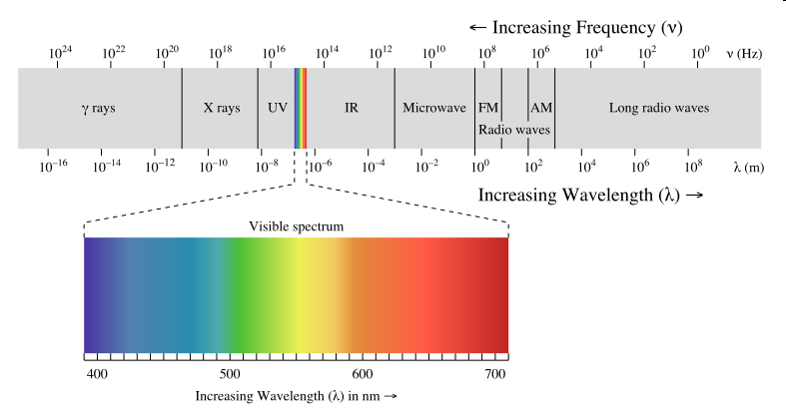
Electromagnetic radiation spectrum

Slide 9
Wavelength of Some Technologies
GSM Phones:
  frequency ~= 900 MHz
  wavelength ~= 33cm
PCS Phones (Personal Communication Service)
  frequency ~= 1.8 GHz
  wavelength ~= 17.5 cm
Bluetooth:
  frequency ~= 2.4GHz
  wavelength ~= 12.5cm
4G cellular phones: frequency = 700MHz - 8GHz
Wi-Fi: frequency ~= 2.4 GHz, 5GHz

Slide 10
Types of electromagnetic carriers
when the distance between the sender and receiver is short (e.g. TV box and a remote control) infrared waves are used
for long range distances between sender and receiver (e.g. TV broadcasting and cellular service) both microwaves and radio waves are used
  radio waves are ideal when large areas need to be coverd and obstacles exist in the transmission path
  microwaves are good when large areas need to be coverd and no obstacles exist in the transmission path

Slide 11
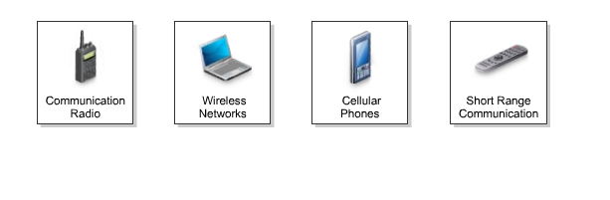
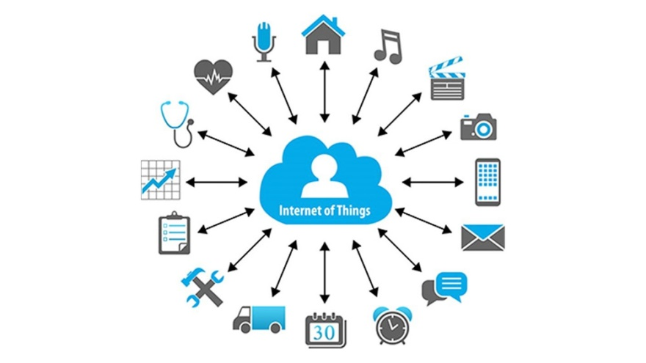
Wireless applications (services)

Slide 12
Advantages and disadvantages of wireless communication
advantages:
  mobility
  a wireless communication network is a solution in areas where cables are impossible to install (e.g. hazardous areas, long distances etc.)
  easier to maintain
disadvantages:
  has security vulnerabilities
  high costs for setting the infrastructure
  unlike wired comm., wireless comm. is influenced by physical obstructions, climatic conditions, interference from other wireless devices

Slide 13
Frequency Carries/Channels
The information from sender to receiver is carrier over a well defined frequency band.
This is called a channel
Each channel has a fixed frequency bandwidth (in KHz) and Capacity (bit-rate)
Different frequency bands (channels) can be used to transmit information in parallel and independently.

Slide 14
Example
Assume a spectrum of 90KHz is allocated over a base frequency b for communication between stations A and B
Assume each channel occupies 30KHz.
There are 3 channels
Each channel is simplex (Transmission occurs in one way)
For full duplex communication:
  Use two different channels (front and reverse channels)
  Use time division in a channel
Station A
Channel 1 (b - b+30)
Station B
Channel 2 (b+30 - b+60)
Channel 3 (b+60 - b+90)

Slide 15
Regulations for the radio (electromagnetic) spectrum
radio spectrum is a scarce resource
it is regulated by global and local authorities; divided into frequency bands and rented for several years to higher bidder by local governments
in Romania, the regulation authority is ANCOM; https://www.ancom.ro/spectru-radio_4688
globally, the International Telecommunication Union (ITU) regulates the radio spectrum
some frequency bands are free like the industrial, science, medicine (ISM) bands - Wi-Fi uses this

Slide 16
Basics of Radio Communication

Slide 17
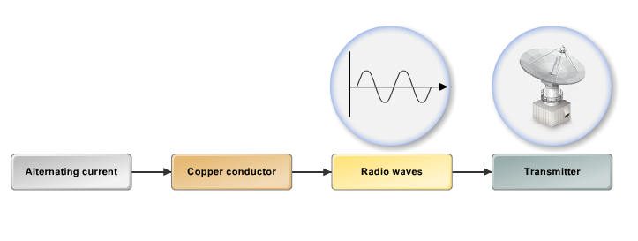
Radio waves generation (1)
when a high-frequency alternating current (AC) passes through a copper conductor it generates radio waves which are propagated into the air using an antena
radio waves have frequencies between:
  3 Hz – 300 KHz - low frequency
  300 KHz – 30 MHz – high frequency
  30 MHz – 300 MHz – very high frequency
  300 MHz – 300 GHz – ultra high frequency

Slide 18
Radio waves generation (2)
the required antenna size for good reception is inversely proportional to the square of signal frequency
higher frequency bands for the service allows for more compact antennas
however, received signal power with nondirectional antennas is proportional to the inverse of frequency squared, so it is harder to cover large distances with higher frequency signals

Slide 19
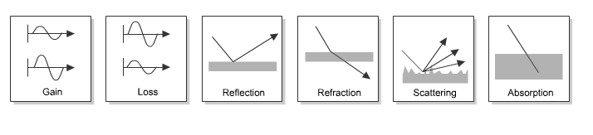
Radio propagation

Slide 20
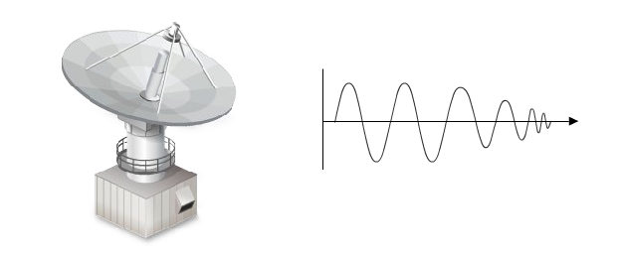
Radio propagation (2)
radio waves are generated by an antenna and they propagate in all directions as a straight line
radio waves travel at a velocity of 186.000 miles per second
radio waves become weaker as they travel a long distance

Slide 21
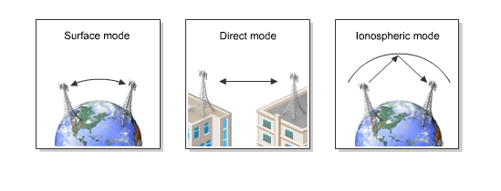
Radio propagation (3)
there are 3 modes of propagation:
  surface mode – for low frequency waves
  direct mode – for high frequency waves
  ionospheric mode – long distance high frequency waves

Slide 22
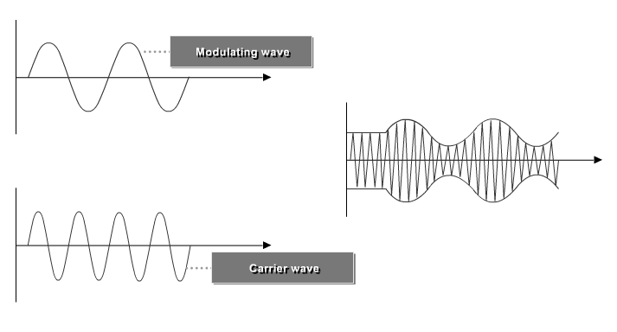
Modulation
modulation = adding information (e.g. voice) to a carrier electromagnetic (radio) signal

Slide 23
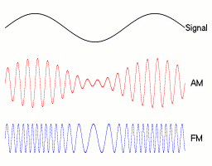
Analog modulation.
Frequency Modulation (FM). Amplitude Modulation (AM).

Slide 24
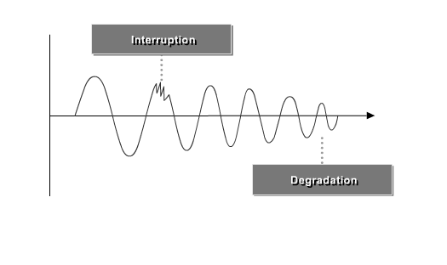
Radio frequency interference

Slide 25
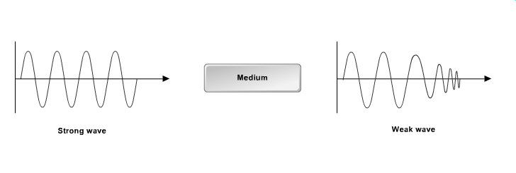
Radio signal attenuation (path loss)

